Slide 1
M
M
3
3
A
A
T
T
H
H
Chapter 2
Review
So we can do our best on the test!

Slide 2
Let’s Review

Slide 3
Review place value

Slide 4
,
T
0
H
T
0
Thousands
1
0
0
0
0

Slide 5
Test your knowledge Use your interactive notebook to help you.
What is the place value of the underlined digit……

Slide 6
79

Slide 7
79

Slide 8
479

Slide 9
5,479

Slide 10
50,479

Slide 11
150,479

Slide 12
Test your knowledge
Round to the nearest…..
Use your interactive binder to help you

Slide 13
50
7
47
4

Slide 14
81
8
1
80

Slide 15
30
25
2
5

Slide 16
3
333
3
300

Slide 17
1
2
3
4
5
6
7
8
9
10
11
12
13
13
14
15
16
17
18
19
20
21
22
23
24
25
26
27
28
29
30
31
32
33
34
35
36
37
38
39
40
41
42
43
44
45
46
47
48
49
50
51
52
53
54
55
56
57
58
59
60
odd
61
62
63
64
65
66
67
68
69
70
71
72
73
74
75
76
77
78
79
80
81
82
83
84
85
86
87
88
89
90
91
92
93
94
95
96
97
98
99
100

Slide 18
170

Slide 19
1
2
5
4
5
6
7
8
9
10
11
12
13
14
15
16
17
18
19
20
21
22
23
24
25
26
27
28
29
30
31
32
33
34
35
36
37
38
39
40
41
42
43
44
44
45
46
47
48
49
50
51
52
53
54
55
56
57
58
59
60
even
61
62
63
64
65
66
67
68
69
70
71
72
73
74
75
76
77
78
79
80
81
82
83
84
85
86
87
88
89
90
91
92
93
94
95
96
97
98
99
100

Slide 20
Test your knowledge
Independent practice.
Work problems 1-11 (ODD) Review book page 29
When you’re finished, check your work!
Then, order these numbers from least to greatest using a math strategy.
7,996 7,942 6,732

Slide 21
What form is this number written in? Write the standard form.
100,000 + 70,000 + 1,000 + 900 + 80 + 2

Slide 22
Test your knowledge
Independent practice.
Work problems 16-28 (EVEN) Review book page 30
When you’re finished, check your work and TURN IT IN!
Be the Teacher!
Create a math problem and write out step-be-step how you solved it, then present it to the class.

Slide 23
Roman
numerals
V
I
X

Slide 24
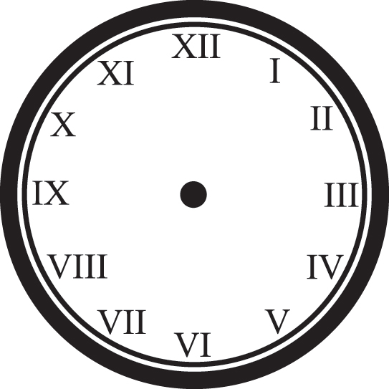

Slide 26
Compare and Contrast

Slide 27
Rules for Using
Roman Numerals
When a smaller number
comes before a larger
number, it is
subtracted from the
larger number.

Slide 28
IV
I
V
5
– 1
= 4

Slide 29
Rules for Using
Roman Numerals
When a smaller number
comes before a larger
number, it is
subtracted from the
larger number.

Slide 30
Rules for Using
Roman Numerals
When a smaller number
comes after a larger
number, it is added to
the larger number.

Slide 31
V
VI
I
5
+ 1
= 6

Slide 32
Test your knowledge Use your interactive notebook to help you. 1.____ 2.____ 3. ____ 4. _____ 5. ____ 6.____ 7. ____ 8. ____ 9._____ 10.____ 11.____ 12. _____
Using the correct rule, convert the roman numeral to the correct Arabic number.

Slide 33
Home Work
Page 34; Work problems 23-27
Place in your homework folder.

Slide 34
What stuck with you today? Which part seems easier now? Which part is still unclear?

