Slide 1
Verb tense
Review and recap

Slide 2
Past and Present
Present-tense Verb
Past-tense Verb
tie
wrap
appear
tied
wrapped
appeared

Slide 3
Prefix
A prefix is a word part that is added to the beginning of a word.
A prefix changes the meaning of the word.

Slide 4
Examples
Un grateful
Dis respectful
Re read

Slide 5
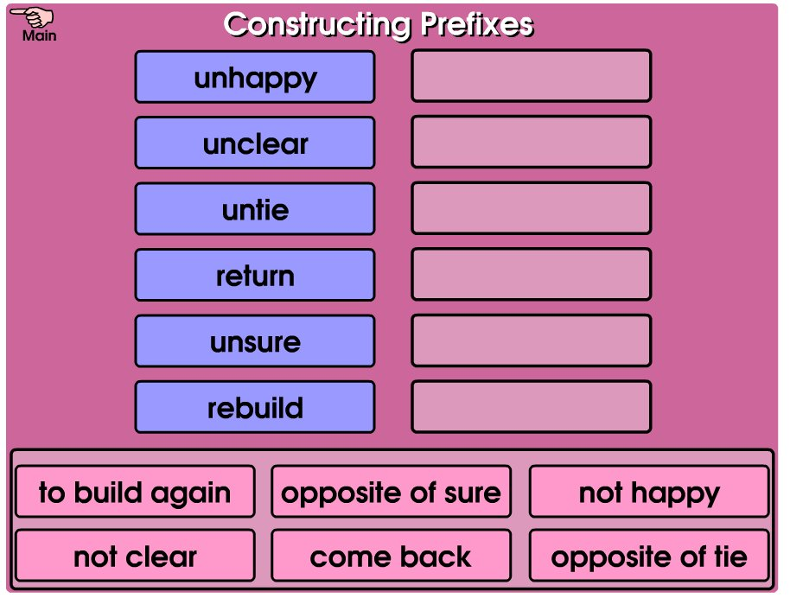
Smart board activity

Slide 6
What stuck with you today? Which part seems easier now? Which part is still unclear?

